Slide 1
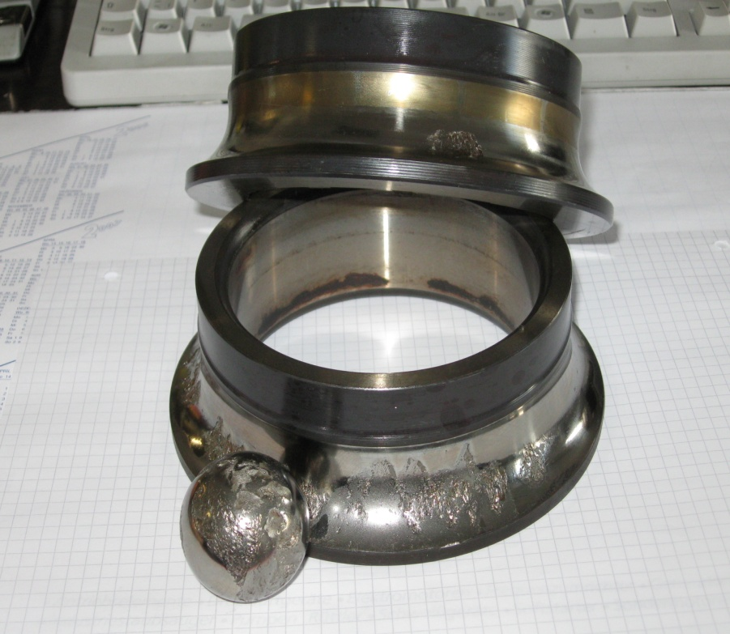
Preventive maintenance
Bearing monitoring
Detect bearing damage in time:

Slide 2

Preventive maintenance
Bearing monitoring
Bearing damage in compressors
Bearing failure is the main cause of major air-end damage.
The rotors touch each other or the casing, and the air end seizes.
Consequential drive damage (coupling, gearbox, belt, motor,
or a fire in the system) is not uncommon.
Bearing damage in compressors
causes substantial costs.
Replacement compressors are not always
available at short notice.
Longer downtime
No compressed air, no production.

Slide 3
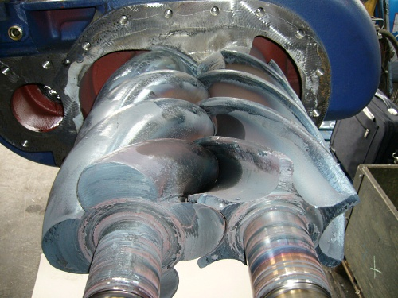
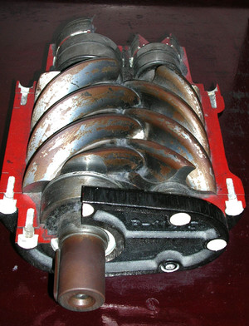
Preventive maintenance
Bearing monitoring
Preventing damage
To avoid expensive air-end damage, replace compressor bearings in good time.
But when? Service life figures are only guidelines; operating conditions differ from site to site.
Source: www.zorn-ingenieure.de/img/maschinenbruchschaeden
Damaged bearings cause higher vibration levels. Suitable vibration monitoring can detect this, but costs several thousand euros.
Because of the high cost, this is only implemented in exceptional cases.
Source: www.deutsches-museum.de

Slide 4
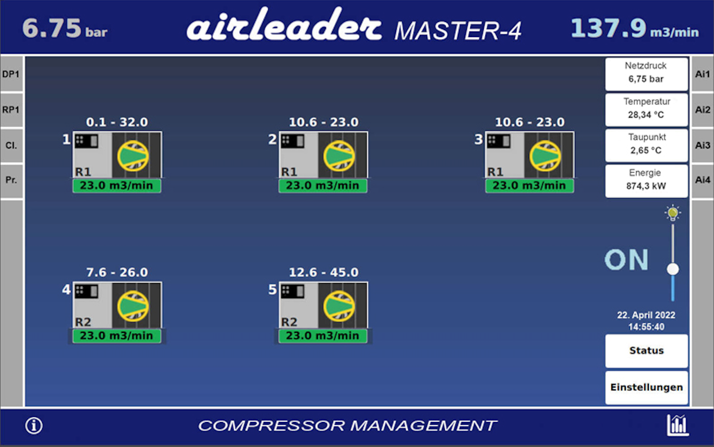
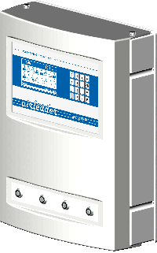
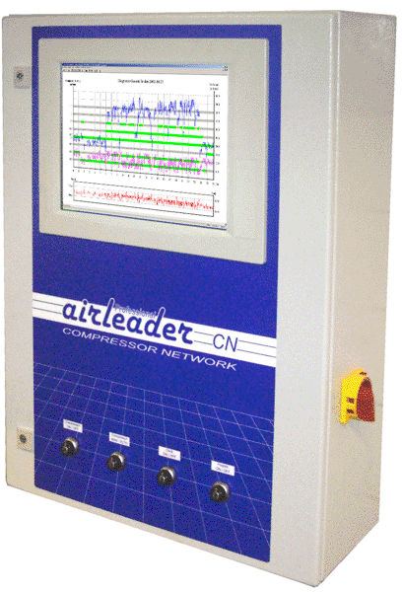
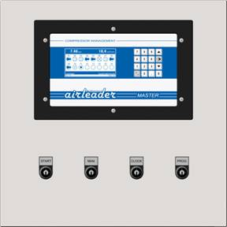
Preventive maintenance
Bearing monitoring
We have made the solution affordable:
Display vibration measurements from 0 to 25 mm/s
in the Airleader MASTER module
and configure individual warning functions.

Slide 5
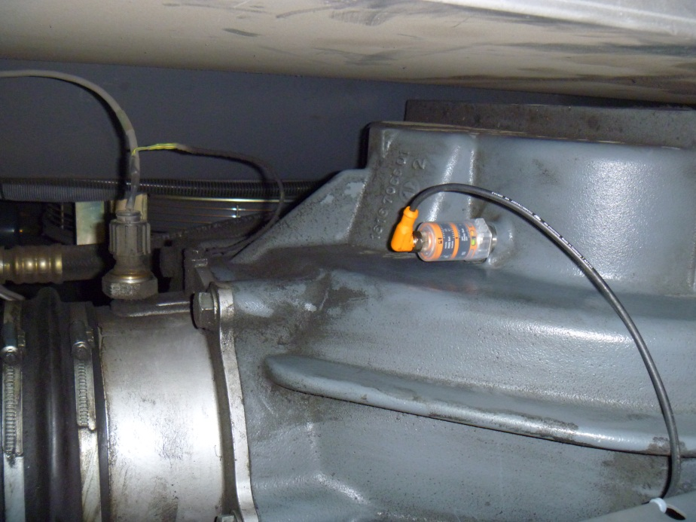
Preventive maintenance
Bearing monitoring
Installation
System requirement: Airleader MASTER module with Web Server PLUS or Airleader CN
Attach the Airleader vibration sensor to the compressor air end using the M8 thread.
Connect a 24 V supply to the vibration sensor.
Use analogue input AI2 on the Airleader connection module.
Configure the sensor in Airleader.
Check normal vibration levels in the visualisation and set the alarm approximately 10-20% above the maximum normal value.
Done!

Slide 6

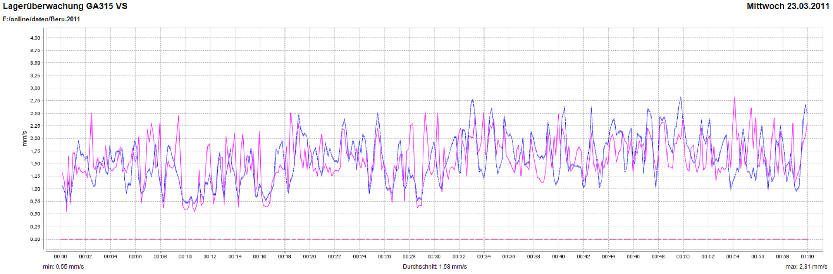
Bearing monitoring
Damage prevention and preventive maintenance
Display in the visualisation
5-8 times higher when damaged!
Vibration velocity
Speed

Slide 7
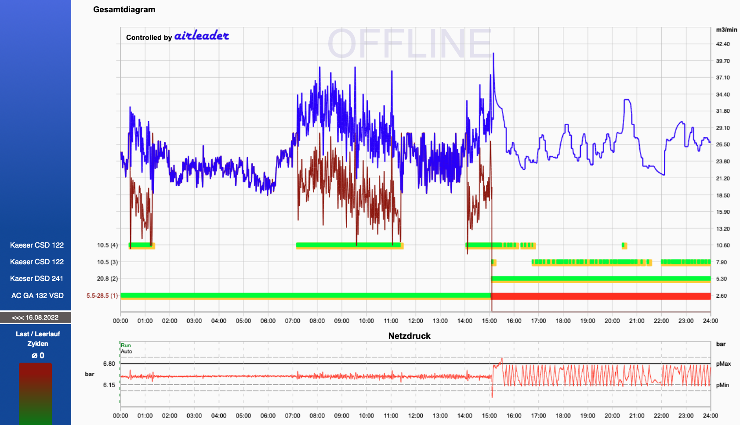
Preventive maintenance
Bearing monitoring
The story of a bearing failure I
Day X (Wed, 17 Aug)

Slide 8
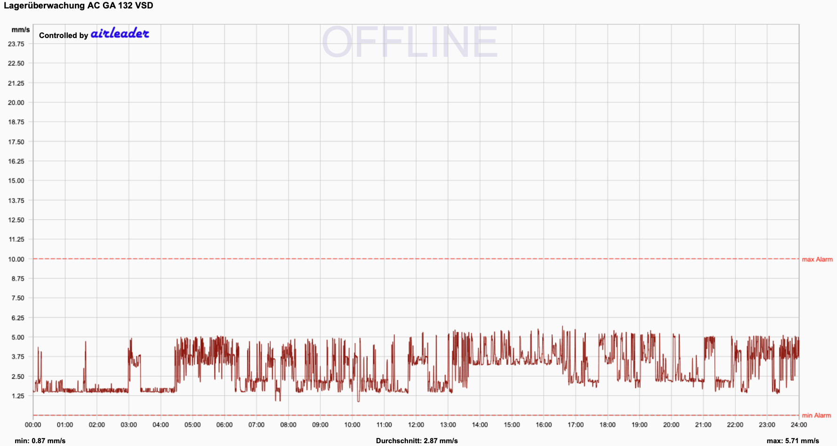
Preventive maintenance
Bearing monitoring
The story of a bearing failure II
Day X - 2 weeks (Wed, 3 Aug)
Vibration velocity vmax = 5.7 mm/s

Slide 9
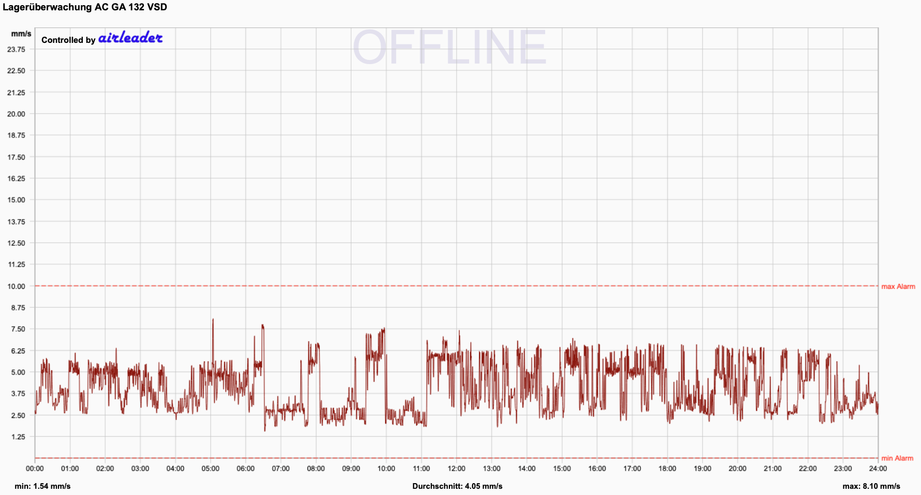
Preventive maintenance
Bearing monitoring
The story of a bearing failure III
Day X - 1 week (Wed, 10 Aug)
Vibration velocity vmax = 8.1 mm/s

Slide 10
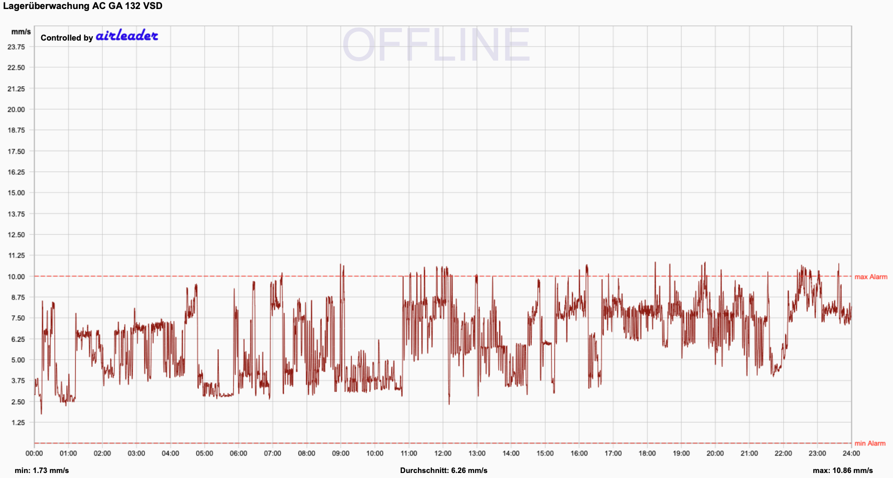
Preventive maintenance
Bearing monitoring
The story of a bearing failure IV
Day X - 1 day (Tue, 16 Aug)
Vibration velocity vmax = 10.9 mm/s

Slide 11
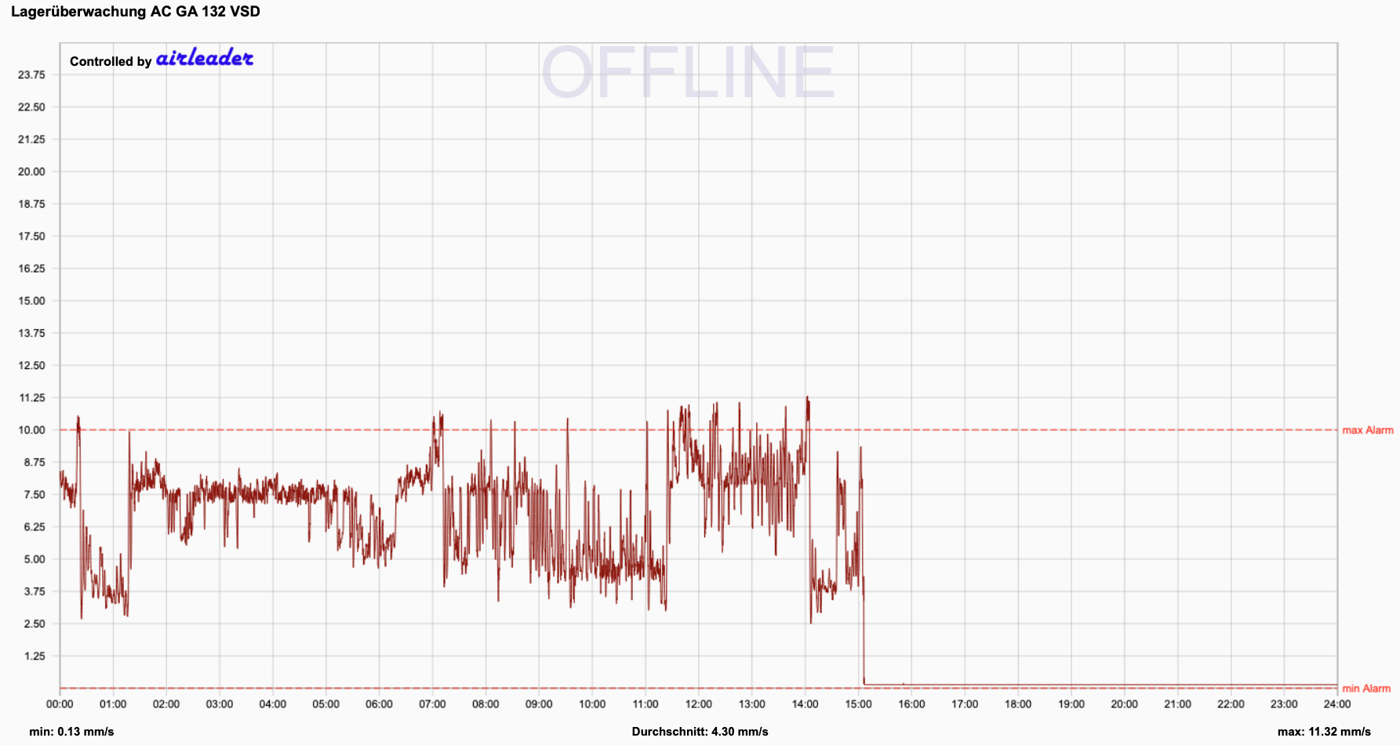
Preventive maintenance
Bearing monitoring
The story of a bearing failure V
Day X (Wed, 17 Aug)
Vibration velocity vmax = 11.3 mm/s
CRASH!

Slide 12
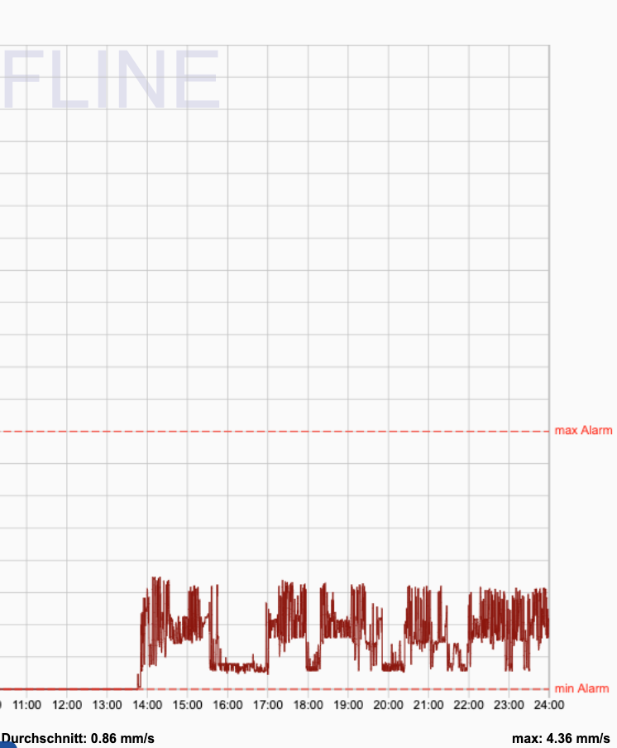

Preventive maintenance
Bearing monitoring
The story of a bearing failure VI
Failure on 17 August
New air end on 7 October
CRASH!
Vibration velocity vmax = 4.4 mm/s

Slide 13
Preventive maintenance
Bearing monitoring
Finding:
Vibration velocity rises a few days before failure.
When Airleader raises an alarm, the operator must stop the compressor immediately (!) and arrange an inexpensive air-end repair.
Set the "max alarm" threshold approximately 10-20% above the maximum normal value.
Tip:
Set the sensor's volt-free contact 20-30% above the maximum normal value.
This takes the compressor out of service if the Airleader alarm is not acted on.

Slide 14
Preventive maintenance
Bearing monitoring
Benefits
Reduced risk of failure.
Replace bearings instead of the entire air end, at a much lower cost.
Condition-based maintenance.
Longer service life.
Reliable production.
Suitable for all makes.
Easy installation (no bearing data to enter, no external personnel, etc.).
Affordable: retrofit approximately EUR 450 per system.

